Slide 1
IST718 Assessing Model Accuracy
Willard Williamson
Adjunct Professor
iSchool, Syracuse University
linkedin.com/in/ncc-1701-d

Slide 2
From The Previous Class
We took a statistical approach to learning which acknowledges our uncertainty and noise in the data science process
We defined a model of the data
We estimated the parameters using training data
We used the model to predict or interpret the results
We could use supervised or unsupervised learning to find relationships between variables
If variables are not quantitative, we used classification models.

Slide 3
Generalization performance
Generalization is the performance of a learning method on independent test data
Generalization performance guides the choice of learning method or model
Why don’t we teach the best method?
David Wolpert: American Computer Scientist and Mathemetician
Because there is no free lunch in statistics: David Wolpert, “The Lack of A Priori Distinctions Between Learning Algorithms“, 1996
A Priori: Reasoning or knowledge which proceeds from theoretical deduction rather than from observation or experience.
Notes:
The no free lunch theorem is one of the best arguments against all the hype happening right now in machine learning. Use whenever possible to shut people’s mouths.
The one liner proof is as follows:
Let A and B be two algorithms (e.g., methods, models)

Slide 4
Generalization performance (2)
The no free lunch theorem implies that we need to
Learn about the particular dataset we are working on (data science!)
Select the best method using generalization performance (data science!)
Essentially, there is no rule that maps the best model to each situation

Slide 5
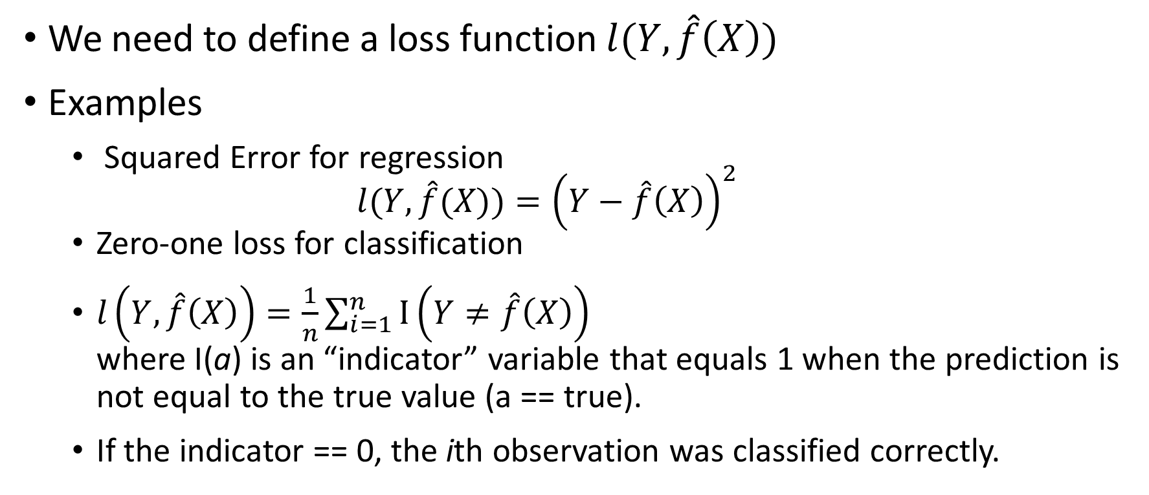
Measuring Generalization Performance: Theory
We need to define a loss function $l(Y,\hat{f}\left(X\right))$
Examples
Squared Error for regression $l(Y,\hat{f}(X))={\left(Y−\hat{f}\left(X\right)\right)}^{2}$
Zero-one loss for classification
$l\left(Y,\hat{f}\left(X\right)\right)=\frac{1}{n}\sum_{i=1}^{n}{I\left(Y≠\hat{f}\left(X\right)\right)}$ where I(a) is an “indicator” variable that equals 1 when the prediction is not equal to the true value (a == true).
If the indicator == 0, the ith observation was classified correctly.

Slide 6
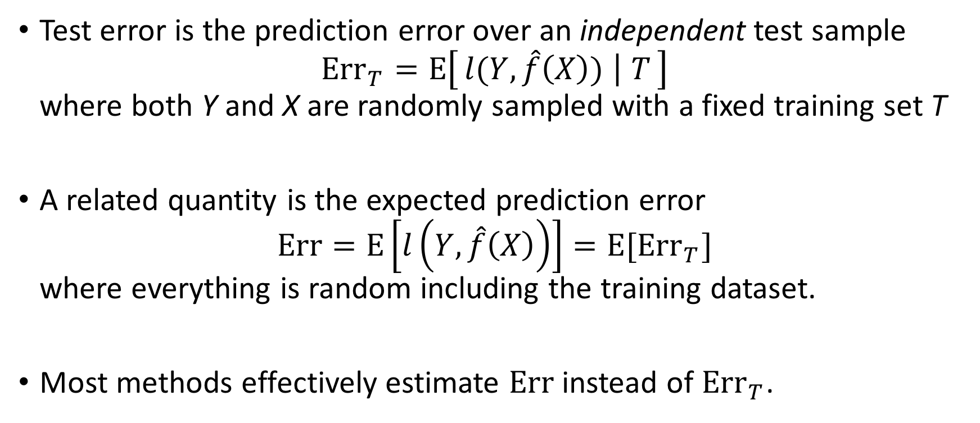
Measuring generalization performance: Test error and expected prediction error
Test error is the prediction error over an independent test sample ${Err}_{Τ}=E\left[l(Y,\hat{f}\left(X\right)) ∣ T\right]$ where both Y and X are randomly sampled with a fixed training set T
A related quantity is the expected prediction error $Err=E\left[l\left(Y,\hat{f}\left(X\right)\right)\right]=E[{Err}_{Τ}]$ where everything is random including the training dataset.
Most methods effectively estimate $Err$ instead of ${Err}_{Τ}$.

Slide 7
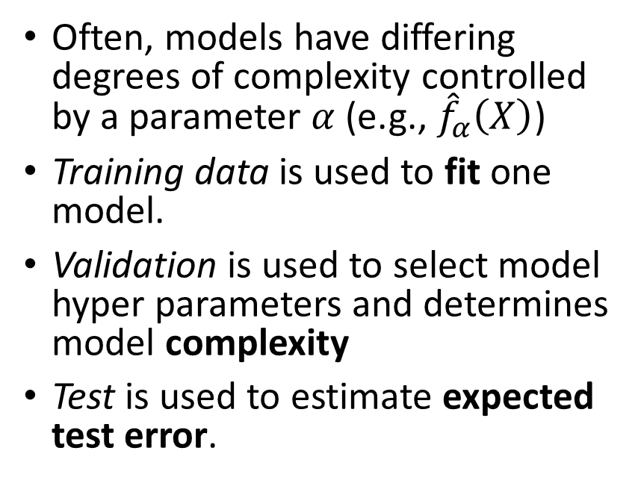
Estimating the expected test error
Model select and assessment
Splits to estimate the expected test error
Often, models have differing degrees of complexity controlled by a parameter $α$ (e.g., ${\hat{f}}_{α}\left(X\right)$)
Training data is used to fit one model.
Validation is used to select model hyper parameters and determines model complexity
Test is used to estimate expected test error.
Train
Validation
Test
Training data
Model fitting
Model selection
Model assessment

Slide 8
Estimating the expected test error: training data splits
The test split should only be used at the end of the data science.
If we compare two models in diabetes dataset: linear regression using BMI (M1) and linear regression using BMI and age (M2) (from the regression_model_comparison.ipynb)
Model fit: M1 MSE (training) = 3723, M2 MSE (training) = 3680
Model selection: M1 MSE (validation) = 4582, M2 MSE (validation) = 4618
Model assessment: M1 MSE (test) = 3925

Slide 9
Estimating the expected test error: variable selection
This procedure can be generalized to answer the question:
Which variables should be included in the model?
One of the simplest such procedures is the forward stepwise selection algorithm (See ISLR 6.1.2):
Start with no predicors
For predictor_count from 0 to num_predictors-1
Fit num_predictors – predictor_count models which add one variable to the current model
If none of the models has lower validation error than current model, then break
Add the predictor with the lowest validation error to the model
Repeat until the next predictor in ‘1’ above does not improve model performance
Return current model
This procedure selects age, bmi, map, tc, ltg, and glu as the most important variable with estimated test error of 3324

Slide 10
Estimating the expected test error: n-fold cross validation
The problem with the previous procedure is that we “don’t use” the validation and test splits to determine validation error (though we could do that).
k-fold cross validation (partially) fixes this by running cross validation multiple times.

Slide 11
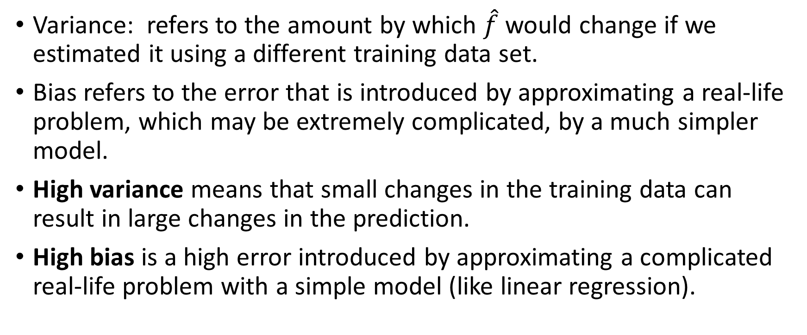
What is Model Bias and Variance
Variance: refers to the amount by which $\hat{f}$ would change if we estimated it using a different training data set.
Bias refers to the error that is introduced by approximating a real-life problem, which may be extremely complicated, by a much simpler model.
High variance means that small changes in the training data can result in large changes in the prediction.
High bias is a high error introduced by approximating a complicated real-life problem with a simple model (like linear regression).

Slide 12
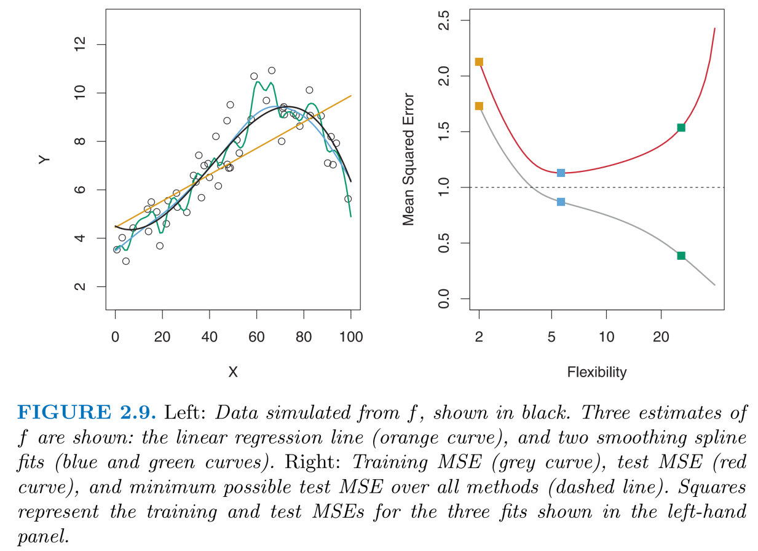
Bias / Variance Tradeoff
High bias: Straight orange line in the left hand plot.
High variance: blue and green lines in left hand plot.
Right hand plot: Gray line shows that as we continue training, training data MSE continues to decrease.
Right hand plot: Red line shows that as we continue training, validation MSE decreases to a minimum and then starts increasing.
Overfitting happens as the gray line decreases while the red line increases in the right hand plot.

Slide 13
The Bias-Variance decomposition
In general, more complex models have low bias and high variance
Vice versa, simple models have high bias and low variance
This is a fundamental tradeoff

Slide 14
The Bias-Variance decomposition (2)
An example with the diabetes dataset
By adding a polynomial expansion to the variables:
bmi, age, bmi*age, bmi^2, age^2, etc.
We will have a new X_{new} matrix with p_{new} = 2p + p(p-1)/2 dimensions and run the following procedure:
Repeat many times
Randomly split the data into training and testing
For k=1 to p_{new}
Fitting model with k randomly selected features and predicting a random
Estimate training and testing MSE

Slide 15
The Bias-Variance decomposition (3)
Overfitting
Low variance
High bias
High variance
Low bias

Slide 16
Bias-Variance decomposition: the learning curve
Simple model doesn’t learn much after 50 examples
Complex model keeps learning
Simple model has better performance with small datasets
Complex model has better performance with big dataset
Notes:
A couple of heuristics:
If testing performance doesn’t change with more data, then we need more features (we don’t need to gather more data!)
If testing performance keeps decreasing with data, then we need more data (expensive)
If testing performance gets worse with data, then we are overfitting (we need to rethink our model)

Slide 17
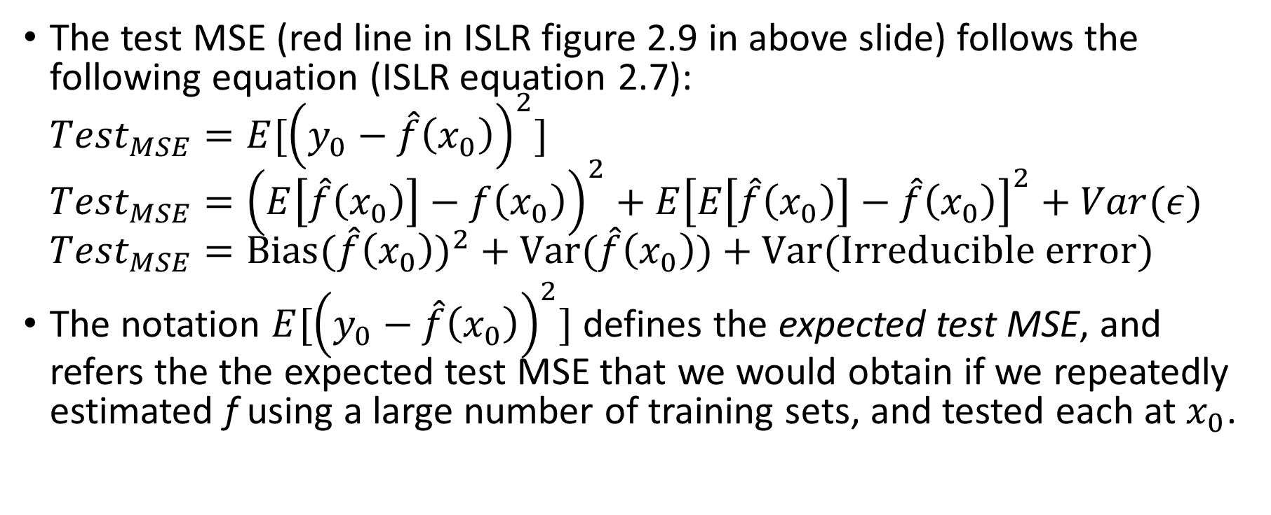
The Bias-Variance Trade Off Equation
The test MSE (red line in ISLR figure 2.9 in above slide) follows the following equation (ISLR equation 2.7): ${Test}_{MSE}=E[{\left(y_{0}−\hat{f}\left(x_{0}\right)\right)}^{2}]$ ${Test}_{MSE}={\left(E\left[\hat{f}\left(x_{0}\right)\right]−f\left(x_{0}\right)\right)}^{2}+E{\left[E\left[\hat{f}\left(x_{0}\right)\right]−\hat{f}\left(x_{0}\right)\right]}^{2}+Var(ε)$ ${Test}_{MSE}={Bias(\hat{f}\left(x_{0}\right))}^{2}+Var(\hat{f}\left(x_{0}\right))+Var(Irreducible error)$
The notation $E[{\left(y_{0}−\hat{f}\left(x_{0}\right)\right)}^{2}]$defines the expected test MSE, and refers the the expected test MSE that we would obtain if we repeatedly estimated f using a large number of training sets, and tested each at $x_{0}$.

Slide 18
Minimizing the Bias-Variance Trade Off Equation
In order to minimize test MSE, we need to select and tune a statistical learning method which simultaneously minimizes bias and variance.
Variance and squared bias are non-negative so test MSE will never fall below the irreducible error term.

Slide 19
Example Model Variance Characteristics
In linear regression, variance is proportional to the number of variables
In nearest neighbors, variance is inversely proportional to the number of neighbors

Slide 20
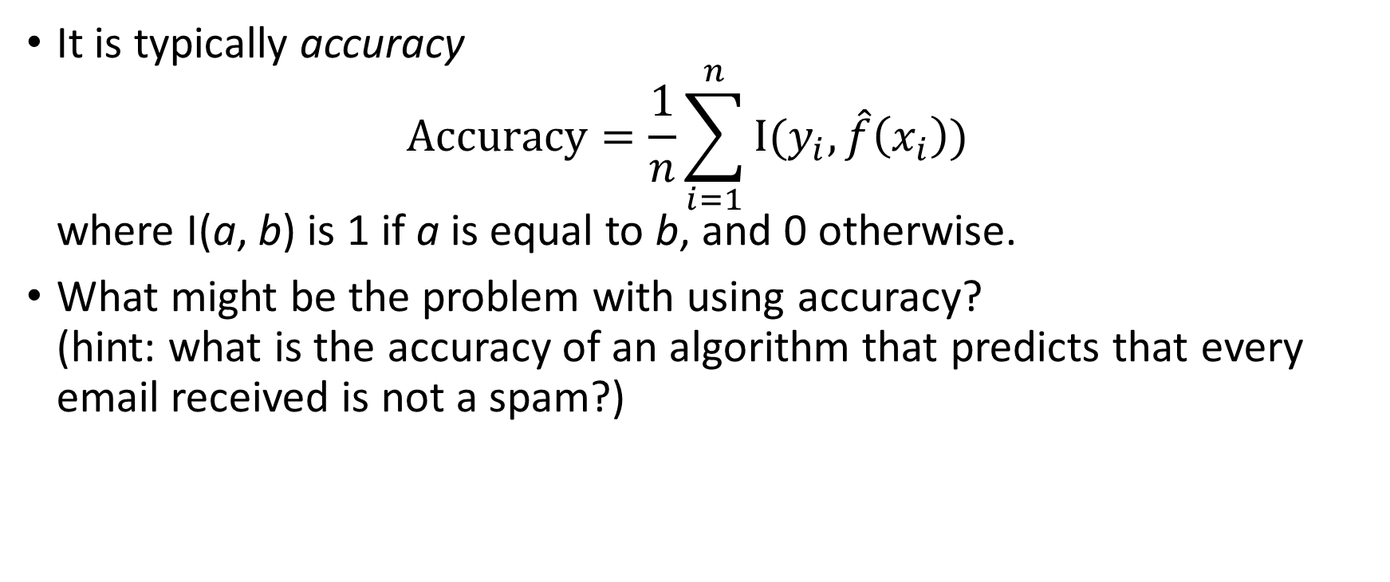
Measuring generalization performance: classification
It is typically accuracy $Accuracy=\frac{1}{n}\sum_{i=1}^{n}{I(y_{i},\hat{f}\left(x_{i}\right))}$ where I(a, b) is 1 if a is equal to b, and 0 otherwise.
What might be the problem with using accuracy? (hint: what is the accuracy of an algorithm that predicts that every email received is not a spam?)
Notes:
Answer: If 1 in 10 emails is a spam, then the model could show 90% accuracy even though it will never predict spam

Slide 21
Confusion Matrix
Accuracy is misleading for unbalanced datasets
Activity: Given one normal email and one spam email, GMAIL can perform a non-spam classification (NS) and spam classification (S). Where would you put all these cases in a confusion matrix?
Assume positive = spam, and negative = not spam
 |  | Predicted condition
 |  | Condition positive (spam) | Condition negative (Not Spam)
True condition | Condition positive (spam) | S/S | ?/?
 | Condition negative (not spam) | ?/? | ?/?
Notes:
There are four cases:
Spam email classified as spam (already in confusion matrix)
Normal email classified as spam (where?)
Spam email classified as normal email (where?)
Normal email classified as normal (where?)

Slide 22
Confusion matrix
Accuracy is misleading for unbalanced datasets
Activity: Given one normal email and one spam email, GMAIL can perform a non-spam classification (NS) and spam classification (S). Where would you put all these cases in a confusion matrix?
Assume positive = spam, and negative = not spam
 |  | Predicted condition
 |  | Condition positive (spam) | Condition negative (not spam)
True condition | Condition positive (spam) | S/S | S/NS
 | Condition negative (not spam) | NS/S | NS/NS
Notes:
There are four cases:
Spam email classified as spam (already in confusion matrix)
Normal email classified as spam (where?)
Spam email classified as normal email (where?)
Normal email classified as normal (where?)

Slide 23
Confusion Matrix
Assume positive = not spam, and negative = not spam
 |  | Predicted condition
 |  | Condition positive (spam) | Condition negative (not spam)
True condition | Condition positive (Spam) | True positive (TP) | False negative (FN)
 | Condition negative (not spam) | False positive (FP) | True negative (TN)

Slide 24
Common statistics from confusion matrix
True positive rate (TPR), recall, sensitivity: TP / true condition positive
True negative rate (TNR), specificity: TN / true condition negative
Precision: TP / predicted condition positive
Accuracy: (TP + TN) / total population
False Positive Rate (FPR): 1 – (TN / true condition negative) = 1 - TNR
Prevalence: true condition positive / total population
See: https://en.wikipedia.org/wiki/Confusion_matrix
 |  | Predicted condition
 |  | Condition positive | Condition negative
True condition | Condition positive | True positive (TP) | False negative (FN)
 | Condition negative | False positive (FP) | True negative (TN)
Notes:
Some examples:
High TPR: TSA (dragnet). They really want to catch every terrorist.
High TNR: pre-operatory exam procedures. If we detect a heart problem, we really need to perform open heart surgery.
High precision: Asset management (anti-theft police). They really don’t want to make false accusations.

Slide 25
Performance Measurement Interpretation
Assume a machine learning test was developed to predict diabetes.
A group of study subjects is collected where some subjects are known to have diabetes and some do not have diabetes.
A true prediction means that a subject is predicted to have diabetes
A false prediction means that the subject is predicted to not have diabetes

Slide 26
Performance Measurement Interpretation
Confusion matrix metrics answer the following questions:
TPR / Recall: Out of all the subjects that were truly diabetic, how many did we predict to be diabetic
TNR / Specificity: Out of all the subjects that did not have diabetes, how many did we predict to not have diabetes
Precision: How many subjects labeled as being diabetic were actually diabetic
Accuracy: How many subjects were correctly predicted to have diabetes out of all subjects in the study

Slide 27
Performance Measurement Interpretation
Confusion matrix metric interpretation
TPR / Recall: Use when false positives are better than false negatives. Using this metric, it’s better to label a healthy subject diabetic rather than a diabetic subject healthy.
TNR / Specificity: Use when you want to minimize false positives. Using this metric, you don’t want to classify any subjects with diabetes that do not have diabetes.
Precision: Use in cases where high confidence in true positives is desirable. Maximizes the chance that a positive diabetes prediction is correct at the expense of missing some subjects that actually have diabetes.
Accuracy: Only works well for balanced data sets. Probably not appropriate for a diabetes test.

Slide 28
Receiver Operating Characteristic (ROC) Curve
ROC was originally developed during world war 2 to measure the ability of radar receiver operators to distinguish between real aircraft targets and “false alarms” on the radar screens.
ROC is typically used for models that predict the probability of 2 class outcomes
The key to understanding ROC
TPR and FPR values are calculated across a range of thresholds where the threshold is compared against the model probability prediction to determine the class
The resulting data is plotted as TPR vs. FPR

Slide 29
Receiver Operating Characteristic (ROC) Curve
The ROC curve uses TP and FP cells in the confusion matrix (shown in red).
A threshold is used to determine spam vs. not spam (see threshold col in table below)
The resulting plot is called a ROC curve
 |  | Predicted condition
 |  | Condition positive (spam) | Condition negative (normal)
True condition | Condition positive (spam) | TP | FN
 | Condition negative (normal) | FP | TN
Email | P(spam) | Threshold Spam if P(spam) > 0.5
Normal | 0.1 | F
Spam | 0.4 | F
Normal | 0.2 | F
Spam | 0.6 | T
Normal | 0.7 | T

Slide 30
ROC Curve
We will classify as spam if classifier predicts with more than 50% spam
TPR: TP / true condition positive
FPR: 1 – (TN / true condition negative) = 1 - TNR
Populate the confusion matrix from the prediction results
 |  | Predicted condition
 |  | Condition positive (spam) | Condition negative (normal)
True condition | Condition positive (spam) | 1 | 1
 | Condition negative (normal) | 1 | 2
True Condition | P(spam) | Predicted Condition Spam if P(spam) > 0.5
Normal | 0.1 | Normal
Spam | 0.4 | Normal
Normal | 0.2 | Normal
Spam | 0.6 | Spam
Normal | 0.7 | Spam
TPR = 1 / 2
FPR = 1 – (2 / 3)

Slide 31
ROC Curve
We will classify as spam if classifier predicts with more than 10% spam
TPR: TP / true condition positive
FPR: 1 – (TN / true condition negative) = 1 - TNR
Populate the confusion matrix from the prediction results
 |  | Predicted condition
 |  | Condition positive (spam) | Condition negative (normal)
True condition | Condition positive (spam) | 2 | 0
 | Condition negative (normal) | 2 | 1
True Condition | P(spam) | Predicted Condition Spam if P(spam) > 0.1
Normal | 0.1 | Normal
Spam | 0.4 | Spam
Normal | 0.2 | Spam
Spam | 0.6 | Spam
Normal | 0.7 | Spam
TPR = 1
FPR = 1 – (1 / 3)

Slide 32
Measuring generalization performance: ROC curve
In the previous 2 slides, we calculated the TPR and FPR for thresholds 0.1 and 0.5
In practice, we would calculate TPR and FPF for many more thresholds than just 2
In this example, we show the two thresholds in the plot below
P(spam) > 0.1
1
P(spam) > 0.5
TPR
0
FPR (1 – TNR)
1
Notes:
Compute the points for a classifier that predicts spam 50% probability

Slide 33
Measuring generalization performance: ROC curve
If we connect a smooth line between the 2 points in this example, we can visualize what the ROC curve might look like if we calculated TPR and FPR for more than just 2 thresholds.
Using the ROC Curve, we can pick threshold values that optimize a desired outcome.
Example: It might be better for a medical test to allow more false positives so the test doesn’t miss a true positive
1
TPR
0
FPR (1 – TNR)
1
Activity: Which point in the plot above is better for the medical test?

Slide 34
Measuring generalization performance: ROC curve (2)
Plot TPR vs. FPF for every threshold value
The Area Under the Curve (AUC) represents the performance
Higher AUC means better performance
The AUC for the red diagonal line represents the “random guess” performance.
1
TPR
Random classifier
0
FPR (1 – TNR)
1
Notes:
Compute the points for a classifier that predicts spam 50% probability

Slide 35
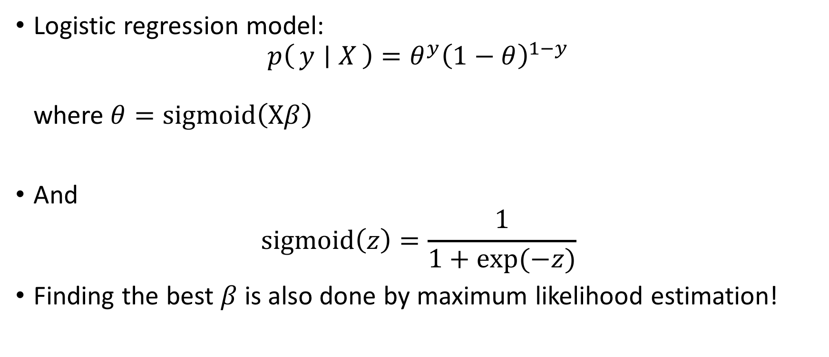
Classification in diabetes example
Logistic regression model: $p\left(y ∣ X\right)=θ^{y}{\left(1−θ\right)}^{1−y}$ where$θ=sigmoid\left(Xβ\right)$
And $sigmoid\left(z\right)=\frac{1}{1+exp⁡(−z)}$
Finding the best $β$ is also done by maximum likelihood estimation!

Slide 36
Classification in diabetes example
Let’s assume that disease progression greater than 250 is really bad
We want to predict really bad progressions
Unbalanced because 10% of people have bad levels of progression
Area under the curve = 0.9
Using all predictor variables

